Slide 1
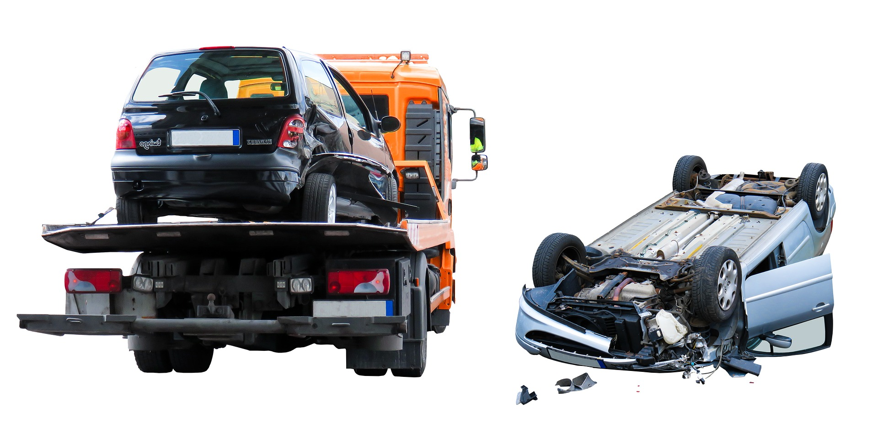
Analysis and Severity Prediction of Vehicle Collisions in the US

Slide 2

Frequency of Collision Occurrences

Slide 3
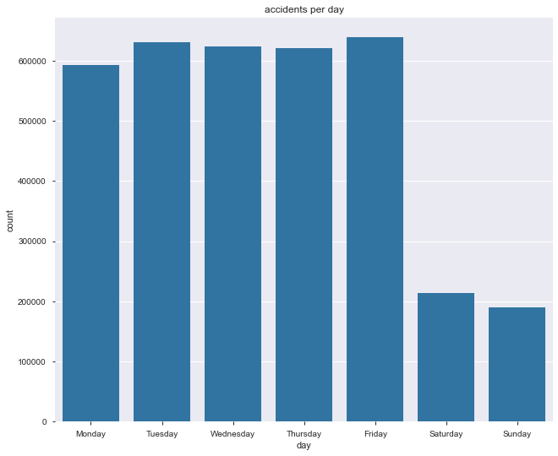
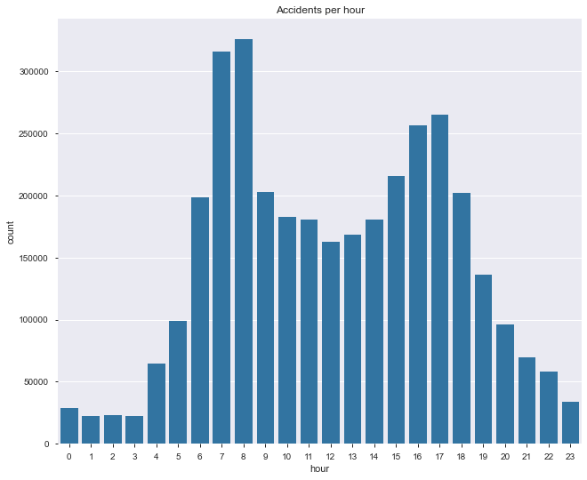
Accident frequency
Accidents occur most frequently during the following times:
During the work week
During rush hour

Slide 4
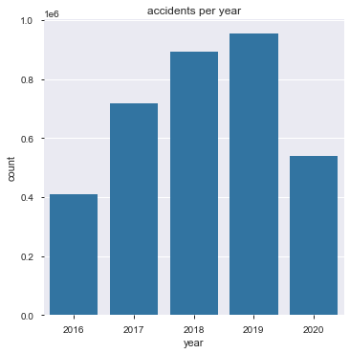
Collision Occurrences
Between 700,000 and 1,000,000 collisions each year
Approx. 1,900 accidents each day of the year
2016 and 2020 were incomplete years
Both represent only half of the year due to data collection period

Slide 5
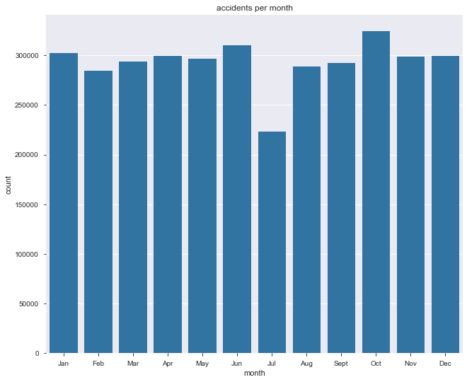
Collisions per month
Strange dip

Slide 6
Collisions per day

Slide 7
Collisions per Hour
Rush hours

Slide 8
Study of Severity

Slide 9
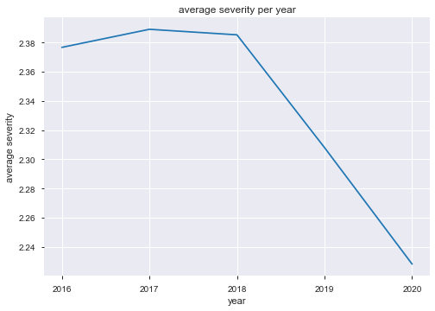
Severity across four years
Severity appears to have decreased since 2016
Several hypotheses:
Better safety equipment has led to less severe accidents
Local measures to educate citizens about dangerous stretches of road
Random chance
More data is required over more years to make a proper determination

Slide 10
Mean Severity per Year

Slide 11
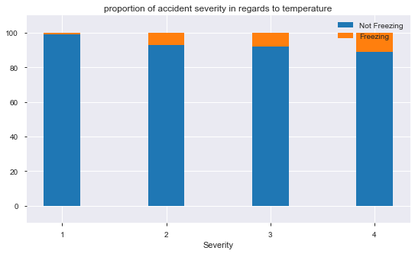
Severity in Freezing and Non-Freezing Conditions

Slide 12
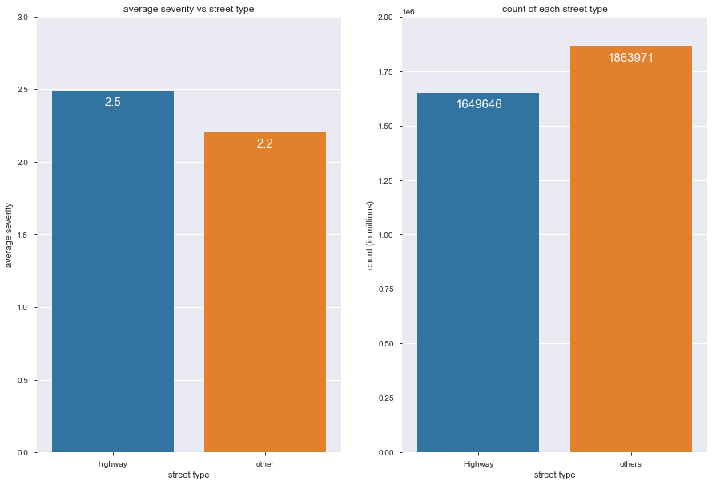
Severity by Street Type

Slide 13
Study of the Top 10 Cities With the Most Accidents

Slide 14
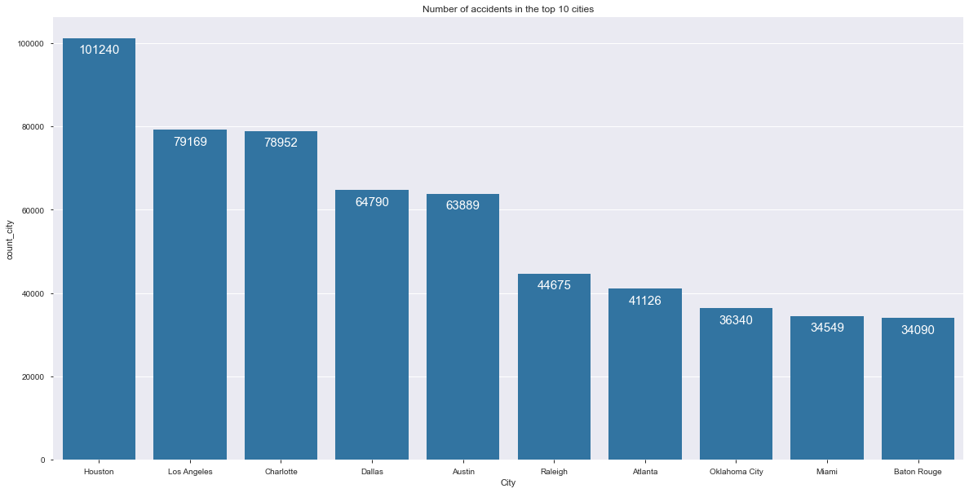
Top 10 Cities
10 cities comprise over 15% of total accidents in the United States
Houston: 101,240
Los Angeles: 79,169
Charlotte: 78,952
Dallas: 64,790
Austin: 63,889
Raleigh: 44,675
Atlanta: 41,126
Oklahoma City: 36,340
Miami: 34,549
Baton Rouge: 34,090

Slide 15
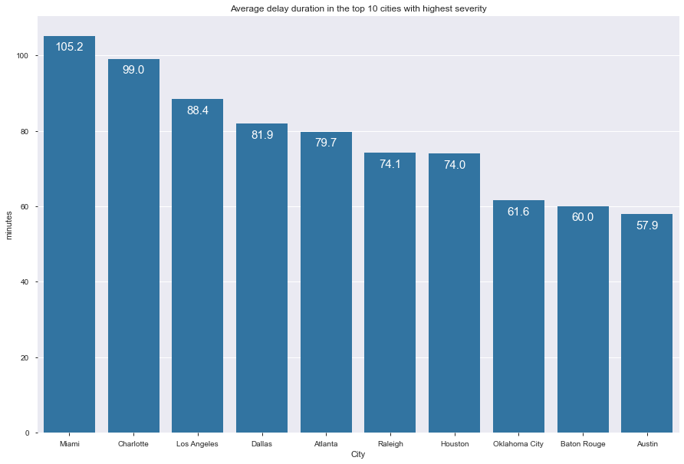
Mean delay from accidents
The mean delay in the top 10 cities varies widely
Miami at 105.2 minutes
Austin at 57.9 minutes

Slide 16
Top 10 Cities

Slide 17
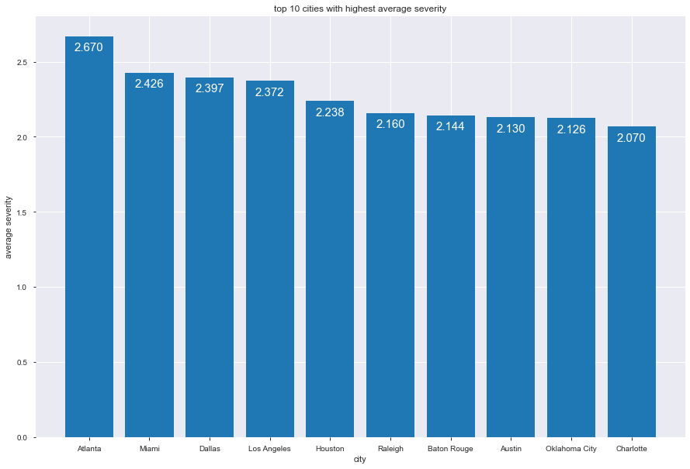
Mean Severity in Top 10 Cities

Slide 18
Mean Delay in Top 10 Cities

Slide 19
Machine Learning
Clustering and Heatmaps

Slide 20
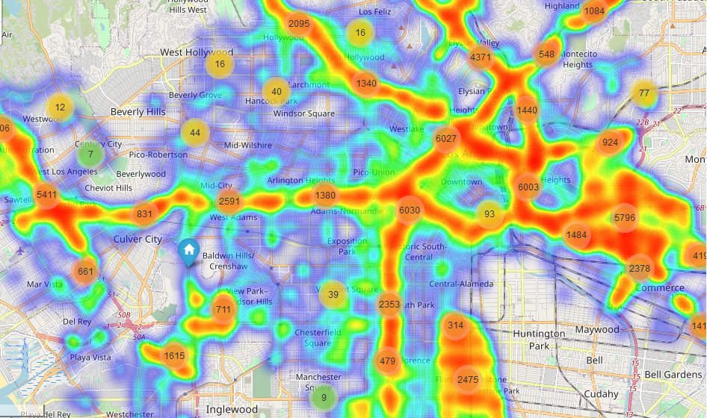
Clustering
Clustering reveals that a large percentage of accidents follow highways
Deep red shows high density of accidents in an area
Note that the deep red areas follow the highway almost exactly

Slide 21
Clustering
Highway junctions are prone to very large clusters
In Los Angeles, at three major junctions with clusters numbering more than 6,000 can be seen

Slide 22
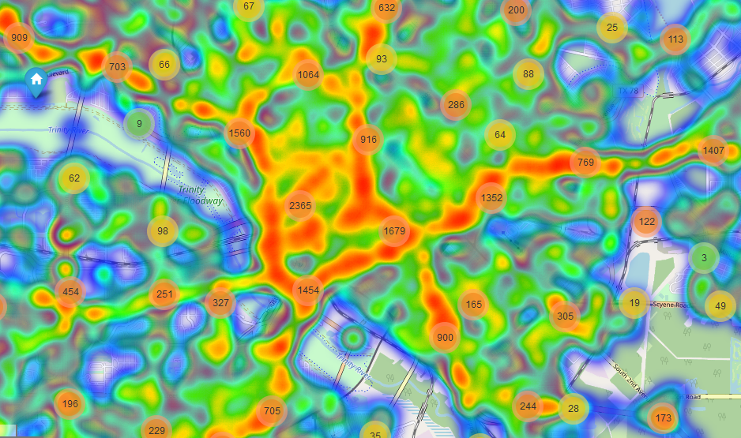
Dallas, TX

Slide 23
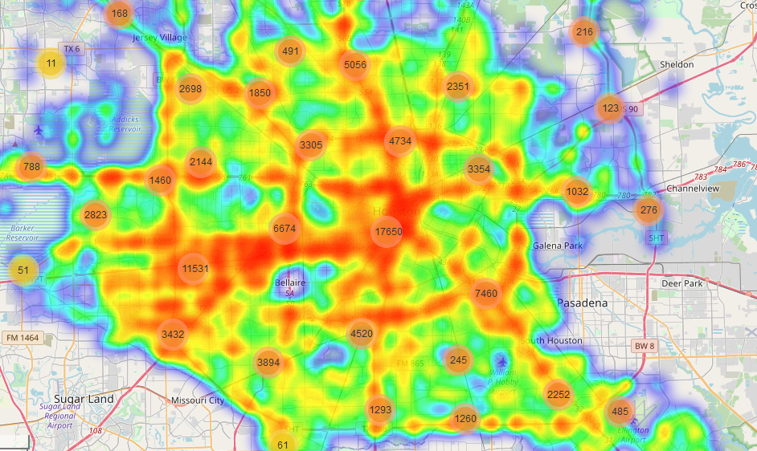
Houston, TX

Slide 24
Los Angeles, CA

Slide 25
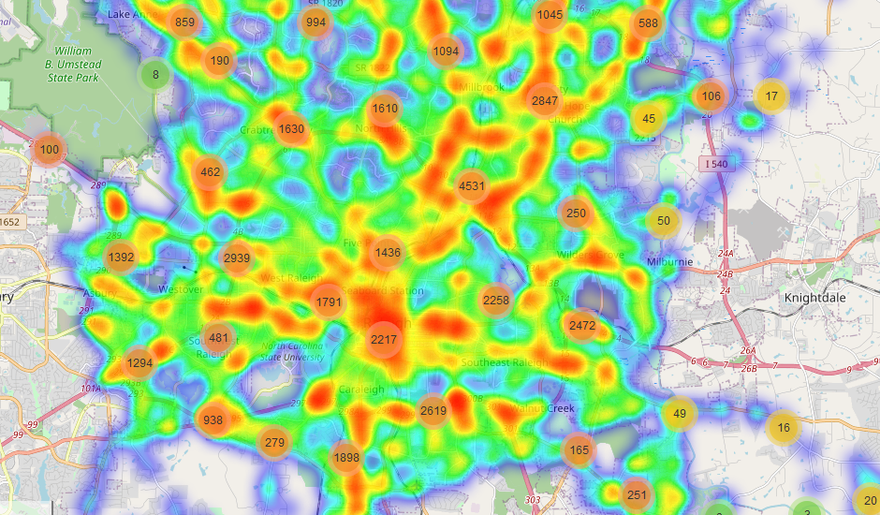
Raleigh, NC

Slide 26
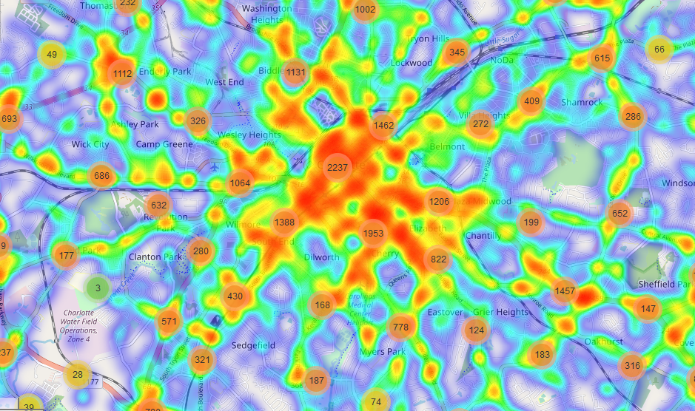
Charlotte, NC

Slide 27
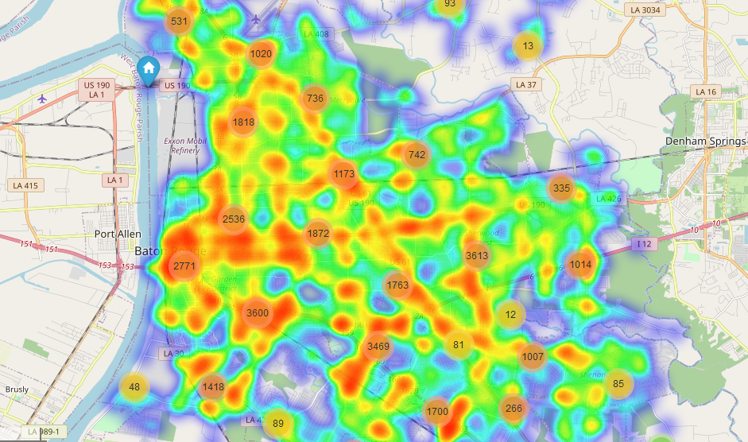
Baton Rouge, LA

Slide 28
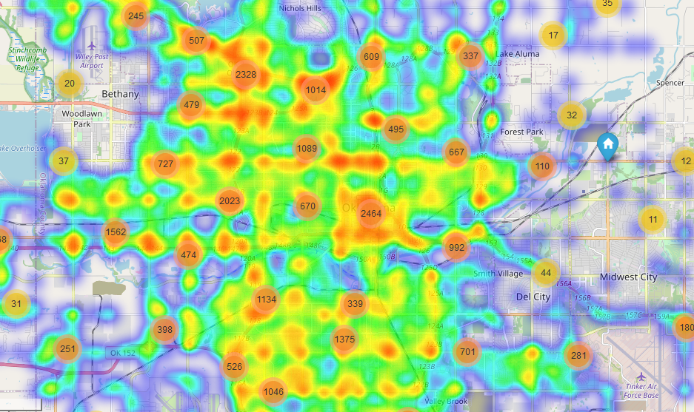
Oklahoma City, OK

Slide 29
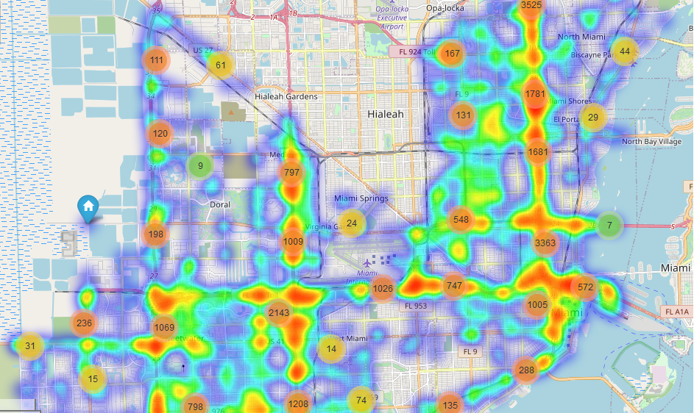
Miami, FL

Slide 30
Machine Learning
Prediction using K-NearestNeighbor

Slide 31
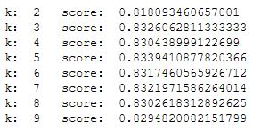
KNN using all possible classes
Dataset has four possible classes for severity (1 – 4)
Using all four classes as possible classifications returns good results using KNN.
Using a ‘k’ of five, a high score of 83.39% is recorded

Slide 32
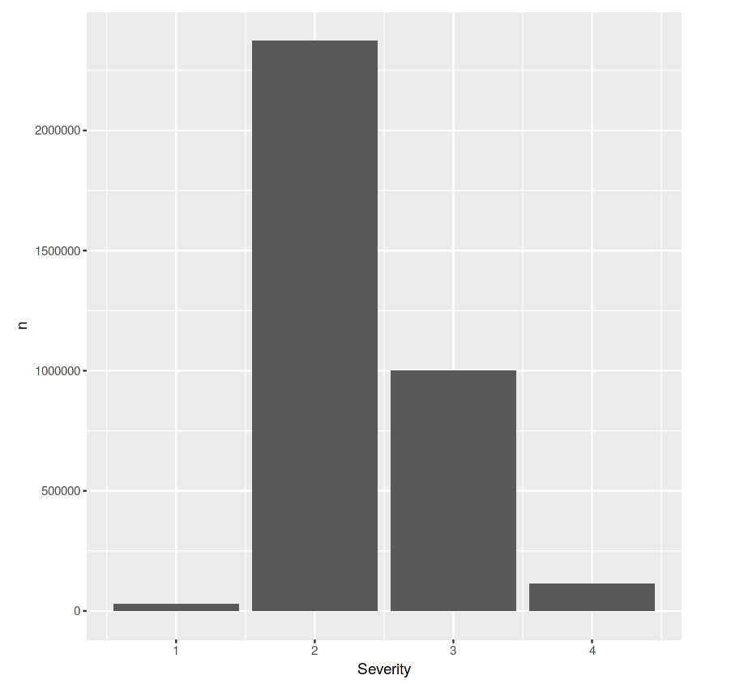
Skewed Distribution
Unfortunately, the model is not able to train properly given that the four are very skewed.
As can be seen, the data is very skewed with the majority of accidents being severity 2 and then severity 3

Slide 33
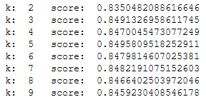
KNN with two super classes
To rectify the imbalance, create two super classes
Severities 1 and 2 are grouped together
Severities 3 and 4 are grouped together
This method shows a score increase to 84.95%

Slide 34
KNN Using Two Different Strategies
Using all 4 accident classes (1, 2, 3, 4)
Using 2 Super Classes (1 & 2 / 3 & 4)

Slide 35
Variables
With the current dataset, the best predictor was by using only location data in the form of latitude and longitude
Adding other variables reduces the accuracy of the prediction drastically

Slide 36
Other Models
Models such a RandomForest and SVM were considered
Unfortunately, they returned results which were far below KNN
KNN returned 83%
RandomForest returned 63%

